Slide 1
BearBuy Forms
Webinar Learning Series
July 2022

Slide 2
Agenda
Using & Completing BearBuy Forms
Specific Forms
Resources
How to get help
Q&A
  Please type your questions into the
  Zoom Q&A as we go
Note: This webinar will be recorded and posted on the Supply
Chain Management website

Slide 3
About BearBuy Forms
Used to place orders, request payment or request purchase order (PO) changes
Only used for purchases when you cannot find the item in the BearBuy catalogs
Catalog purchases are easier and require less paperwork
Common purchases using forms:
  Services
  Gases
  Shredding

Slide 4

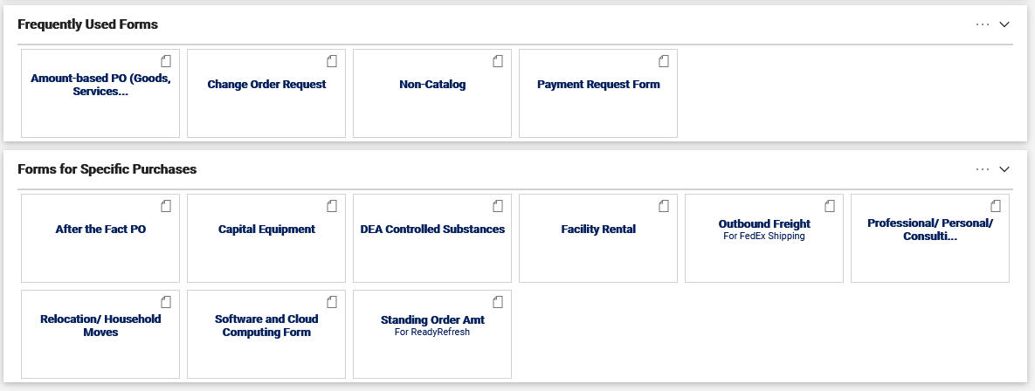
Where to Find Forms
Available on the bottom of the BearBuy home page
Identified by a paper icon in the upper right
Hover over the name and click the for a description

Slide 5

Choosing & Using Forms
Choose the form that is appropriate for your specific purchase
Click the form name to open the form
Carefully read all the instructions on the form
Follow links to more detailed guidance

Slide 6
Completing Forms
Begin by typing a supplier name in the Enter Supplier field
  A list of suppliers matching your entry appears in the dropdown as you type*
  Choose the supplier and confirm the name and address listed matches your supplier’s information
  Some suppliers have more than one address. Click on the select different fulfillment center link on the form after selecting the supplier to select the address for your supplier.
Enter all information on the form fields (in bold) and be descriptive in each field
  *If the desired supplier does not appear, click the Request a New Supplier link to access Supplier Registration
  forms to add a new supplier to BearBuy

Slide 7

Adding Attachments to Forms
Attach any required or relevant documentation, such as a quote or contract
Click the Add Attachments button to attach internal or external attachments
  Internal attachments are only viewable within BearBuy
  External attachments are viewable in BearBuy and a copy is sent to the supplier
  If an attachment needs to be sent to the supplier and viewed by UCSF, attach only in the External Attachments section
    Do not attach the same file to both internal and external attachments.
    The supplier only needs one copy of each document

Slide 8
Adding a Form to a Cart
When the form is complete, scroll to the top of the form
In the Available Actions menu, select Add and go to Cart to add the form
to your cart
Tip: You can also select another applicable option from the dropdown menu
  Add to Cart and Return: Adds form to your current shopping cart. The form stays open and retains the selected supplier.
  Add to Cart: Adds form to your current shopping cart. The form page retains all data entered in the form and eliminates redundant data entry.
  Add to Favorites: Add the completed form as a favorite with all information completed so you can easily place the same order again

Slide 9


Separate Taxable & Non-Taxable Lines
Taxable and non-taxable items need to be separated
  Complete one or more forms for taxable items and add to your cart
  Complete one or more forms for non-taxable items and add to your cart
In your cart
  If the line is taxable, confirm the Taxable checkbox is checked
  If the line is non-taxable, confirm the Taxable checkbox is unchecked

Slide 10
Non-Catalog Form
For requesting goods not available in the catalog
Orders should be for a specific quantity and unit price of items
Different lines should be created for different products with different prices
Use the Amount-Based PO Form for blanket orders. Do not use this form as a blanket purchase order for goods or services

Slide 11
Amount-Based PO Form
Purchase common services such as gas and water deliveries, standard lab tests and diagnostics, DNA sequencing, transcription services, janitorial, equipment repair/maintenance and audio-visual services.
Suppliers often refer to the Amount-Based PO as a "blanket" purchase order or “standing” purchase order.
Do not use this form to order Professional/Personal/Consulting Services, such as accountants, private investigators, professional, personal or consulting services.
Do not use this form for catering, capital equipment (>$5,000), DEA-controlled substances or cloud-based software or for household moving and relocation services as part of a new campus hire.

Slide 12
Professional/Personal/Consulting Services Form
Professional Services
  Provided by a licensed professional
Personal Services
    Provided by someone distinctly qualified to render the service
Consulting Services
  Services of an advisory nature, provide a recommended course of action or personal expertise, have an end product which is a transmittal of information either written or verbal, and is related to University administration and management.”
Notes:
Professional Services
Professional Services are services provided by a licensed professional. Examples include services provided by Medical Professionals, Accountants and Private Investigators.
Personal Services
Services provided by someone distinctly qualified to render the service. Examples include translation services, coaching, art installations and works, contracting with musicians, and buying photography services or photographs
Consulting Services
Consulting Services are “services which are of an advisory nature, provide a recommended course of action or personal expertise, have an end product which is basically a transmittal of information either written or verbal, and which is related to University administration and management.”

Slide 13
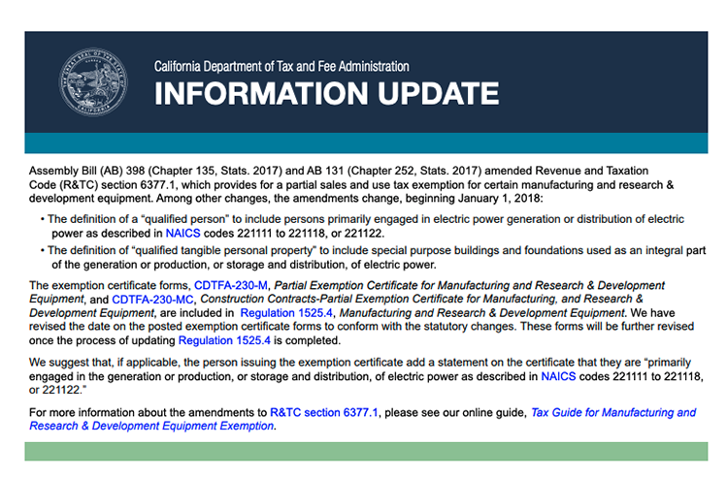
Capital Equipment Form
For requesting equipment costing $5,000 or more with a life expectancy of more than one year
If your order qualifies for the CA Partial Sales and Use Tax Exemption, attach a completed Partial Exemption Certificate as an external attachment on the form

Slide 14

DEA-Controlled Substances Form
Purchase United States Drug Enforcement Administration (DEA)-controlled substances, including Schedules II – V and List I Chemical Precursors

Slide 15
Software and Cloud Computing Form
Cloud Computing Services - Model for delivering applications, information, infrastructure and/or services as pools of resources via the internet.
New software or software licenses
Software maintenance contract renewal or software license agreement renewal (see notes)
Do not use this form to purchase software found in the SHI punch-out catalog.
Notes:
Cloud Computing Services - Model for delivering applications, information, infrastructure and/or services as pools of resources via the internet.
For more information, review UCSF IT Security Cloud Computing Guidance.
New software or software licenses (other than exclusions listed in the “Do Not Use the BearBuy Software and Cloud Computing Form to Purchase” section below).
Software maintenance contract renewal or software license agreement renewal, only when:
Supplier has access to UC PHI, and/or
Supplier has access to UC non-public information, information resources and/or protected information (defined here), and/or
Scope of work has changed
Do not use this form to purchase software found in the SHI punch out catalog.

Slide 16

Relocation/Household Moves Form
Used only when a UCSF campus department is contracting with
a moving company to provide moving and relocation services
as part of a new campus hire
University pays the cost of transporting household
goods and personal effects directly to a common carrier
or household mover.

Slide 17
Facility Rental Form
For requesting an off-site, non-UC facility rental for events requiring
a signed contract
Deposits and payments are not automatically paid
  After the PO has been created, submit a Supplemental Form for any deposit or payment due
  A completed Supplemental Form must be submitted with each facility rental payment or deposit
  The invoices and Supplemental Form should be emailed to Accounts Payable. The invoices are not submitted through Transcepta.

Slide 18
After the Fact PO Form
For requesting payment of an invoice for goods/services only when a purchase order was not previously created for the purchase and the transaction doesn’t fit the limited scope of the Payment Request Form.
An after-the-fact purchase is a procurement that has been committed
to the vendor without proper authorization.
A completed After the Fact Justification Form must be attached along
with your invoice
The form can only be signed by Director, Principal Investigator or Department Chair/Head
The After the Fact voucher must be approved by your department Voucher Approver before it can be paid
Notes:
For requesting payment of an invoice for goods/services only when a purchase order was not previously created for the purchase and the transaction doesn’t fit the limited scope of the Payment Request Form.
An after-the-fact purchase is a procurement that has been committed to the vendor without proper authorization. Per University of California policy BUS-43: “An individual who has not been delegated purchasing authority who makes an unauthorized purchase of goods or services shall be responsible for payment of the charges incurred.”
A completed After the Fact Justification Form must be attached along with your invoice on this form
The form can only be signed by Director, Principal Investigator or Department Chair/Head
The After the Fact voucher must be approved by your department Voucher Approver for any amount before it can be paid

Slide 19
Standing Order Amount Form
For purchasing water delivery services from ReadyRefresh, a systemwide vendor
Contact ReadyRefresh directly to open an account
The form will default the supplier to ReadyRefresh
Product Description: Enter your ReadyRefresh Account Number
Price: Enter a dollar amount.
Special Instruction to supplier: If you need to replace an older ReadyRefresh PO, please enter a comment, e.g., "Please replace PO B001234567 for this account” and contact ReadyRefresh to update your account.

Slide 20
Outbound Freight Form
FedEx outbound (sent from UCSF) shipping
Purchase order issued to our outbound freight partner, Vantage Point Logistics (VPL)
Supplier name: auto-filled as Vantage Point Logistics
Product Description: enter a description and include your FedEx account number
Price: Enter a dollar amount.
Create one default PO and additional POs if you will use different funding for shipments
You must reference the PO number on your shipping label
Shipment invoices will be sent electronically to BearBuy and applied to your PO
Reports sent every month for reconciliation
Only close the PO if you do not have any more invoices for that PO or you will
no longer be participating in the program

Slide 21
Change Order Request Form
For requesting changes to a BearBuy Purchase Order that has been sent to the supplier or closing a PO and removing the lien
  PO Number: Provide your PO number
  Send Change to Vendor: Select “Yes” only if the supplier requires a revised PO
  to fulfill the order
  Type of Change: Categorizes the change; chose the closest category
  New PO Total: PO amount plus the amount of the increase
  Change Request Details: Always detail and explain your changes clearly and provide reasons for the change

Slide 22

Change Order Request Form Tips (1)
Chartfield (Accounting Codes Changes)
Ensure your chartfield combination is valid before submitting
a chartfield change
  The SpeedType Search and Chartfield Validator tool can
  validate chartfields
If a PO is already fully or over-invoiced and fully matched,
the chartfields of a PO cannot be changed
Chartfield changes will apply only to future invoices
  To request changes to vouchers, contact the Response Team
If an order was fulfilled and no more invoices are expected, do not change the chartfields, but request the PO be closed instead if not fulfilled
Tips

Slide 23
Change Order Request Form Tips (2)
PO Closure & Liens
Before closing POs, check if order is completely fulfilled and all vouchers
have been paid
  No vouchers are pending approval or payment
  Do not close POs if items are back-ordered and you expect to receive/pay for the items
  POs can be re-opened on a case-by-case basis
POs created using payment request form do not need to be closed
To review liens, use PeopleSoft or MyReports (Managing Liens Guide)

Slide 24
Payment Request Form (1)
Request payment only for activities specified in the Activity Type drop-down box
Do not use this form for:
  Buying goods and services not listed in the Activity Type drop-down box
  BearBuy PO Invoices
  Research Subjects
  Patient Refunds
  Petty Cash
  Subcontract Invoices
This form cannot be used to pay suppliers who accept purchase orders.
If you have not created a purchase order for your expenses, please use
After The Fact PO Form.

Slide 25
Payment Request Form (2)
Supplier: Enter supplier name.
Attachment to Check Required: Select "Yes" only if there is a required document to be mailed with the check. Attach as an Internal Attachment.
Payment message?: Select "Yes" only if a message is required on the payment advice, such as a license number, member name/ID, account number, type of fee.
Payment Message: Description of payment
printed on remittance to supplier
Activity Type: From the dropdown, select the
Activity Type that matches your transaction
ACTIVITY TYPES
Cell Phone/Phone Lines | Donation/Contribution (Requires approval and documentation) | Government Fees/Visas
Guest Lodging | Honorarium | Journal Publications
Memberships | Postage/Small Package Courier | Refund
Registration Fee | Student Summer Programs | Subscriptions Utilities

Slide 26
Payment Request Form (3)
Product Description: Enter the description and clear reason for payment
Supplier Inv #: Enter the invoice number exactly as it appears on your invoice or document including special characters
  If there is NO invoice number, enter the account number, year, month and day
  If there is no account number, enter the year, month and day only
Invoice Date: Enter the invoice date exactly as it appears on your invoice
Amount: Enter the total payment amount
Does this payment include sales tax?: Review invoice, select "Yes" or "No"
Attachments: Attach a copy of all supporting documentation and an invoice

Slide 27

Meeting & Entertainment Payment Request Form (1)
Use for requesting payment to a supplier for event related expenses where the supplier does not require a contract
  If the supplier requires a contract, use the Facility Rental Form
Expenses for entertainment must be directly related to official University business
For guidelines on Meeting and Entertainment, refer to policy BUS-79
Must be approved by your department’s authorized
Meeting & Entertainment Approver
For on campus catering, use America To Go
If your supplier accepts purchase orders, consider
creating a purchase order
  Photography services should be on a
  purchase order

Slide 28
Meeting & Entertainment Payment Request Form (2)
Supplier: Enter the supplier name. Suppliers that have a stop sign next to their name can be selected.
Attachment to Check Required: Select "Yes" only if there is a required document
to be mailed with the check. Attach the document as an Internal Attachment
Payment Message: Description of payment printed on remittance to supplier
Type of Payment: Select Advance Payment (Deposit), Regular Payment or Final Payment
Type of Expense: Check all that apply - breakfast, lunch, dinner, light refreshments, buffet, other meeting expenses
Business Purpose: Select an option from the dropdown
Description and Business Purpose: Clearly describe the reason for the event and attach supporting documentation

Slide 29
Meeting & Entertainment Payment Request Form (3)
A-21 Allowable: Defines if the cost is directly attributable to a Federal Funding Source
Event Date(s): Enter the event date(s).
Number of Participants: Enter the number of participants.
Names/List of Participants: Enter the number and names of attendees on the form or attach a list (not required for deposit payments)
Host Name: Enter the name of the official UCSF host, if there is one. The host attends the event. If no host, enter N/A.
Amount: Enter the dollar amount to be paid for this payment only
Supporting documents:
  Advance payments/deposits: Attach a copy of deposit invoice or supplier memo
  Final payment: Provide copy of final invoice with a detailed breakdown

Slide 30
Source Selection & Price Reasonableness Form (1)
Only complete this section for Federally-funded orders ≥ $10,000 (including tax and shipping)
And/or non‐federally funded purchases ≥ $100,000 (excluding tax, but including shipping)
For orders =/> $100,000, please contact your department-assigned buyer prior to submitting the form.
If selecting Non-Formal Quotes, attach three qualifying competitive quotes to the Attachments section at the bottom of the form.
The SSPR form is embedded in each Bearbuy form. Use the SSPR form in BearBuy versus the Adobe PDF version, as it is simpler.

Slide 31
Source Selection & Price Reasonableness Form (2)
Source Selection
The process of selecting and contracting with the most qualified proposal that meets UCSF’s requirements. There are four options that can be selected:
New or Existing Bid – Transactions $100,000 or more must have a new or existing formal competitive bid. This must be performed by a Supply Chain Management buyer. If bidding has not occurred, contact your department-assigned buyer early in the process.
Non-Formal Quotes – For federally funded transactions under $100,000, competitive non-formal quotes can be obtained by the department in lieu of the formal bidding process. The department should collect a minimum of three informal quotes from different vendors and attach them to the BearBuy requisition.
Notes:
Source Selection
The process of selecting and contracting with the most qualified proposal that meets UCSF’s requirements. There are four options that can be selected:
New or Existing Bid – Transactions $100,000 or more must have a new or existing formal competitive bid. This must be performed by a Supply Chain Management buyer. The buyer will run the competitive bid in CalUsource and will evaluate a minimum of three qualified bids before moving forward with the requisition (informal quotes do not meet this requirement).
If bidding has not occurred, contact your department-assigned buyer. Specific bidding activity may take weeks or months, we advise you to contact your buyer early in the process.
Non-Formal Quotes – For federally funded transactions under $100,000, competitive non-formal (informal) quotes can be obtained by the department making the purchase, in lieu of the formal bidding process. The department should collect a minimum of three informal quotes from different vendors and attach them to the BearBuy requisition.

Slide 32

Source Selection & Price Reasonableness Form (3)
Source Selection (continued)
Registered Small Business – Transactions involving small business under $250,000 are exempt from providing informal quotes.
Sole Source – Transactions under $100,000 where there is only one solution or option that meets UCSF’s requirements. If selected, you will be required to complete both the sole-source justification and price reasonableness portions of the BearBuy form.
Notes:
Source Selection continued
Registered Small Business – Transactions involving small business under $250,000 are exempt from providing informal quotes.
Sole Source – Transactions under $100,000 where there is only one solution or option that meets UCSF’s requirements. If selected, you will be required to complete both the Sole-Source Justification and the Price Reasonableness portions of the BearBuy form.

Slide 33
Source Selection & Price Reasonableness Form (4)
Price Reasonableness
The price paid by the University must be reasonable, one that does not exceed what would be incurred by a prudent person in a competitive business. Required by the California Public Contract Code and the Federal Acquisition Regulation (FAR). This information must be documented in the BearBuy requisition.
Documenting Reasonable Price:
The following are examples of how to substantiate price reasonableness, together with a discount (discount alone is not justifiable), in order of preference:
  Price competition – comparison of quotes
  University of California Office of the President (UCOP) systemwide agreement, State, or GSA contract pricing, or comparison with prices under existing contracts
Continued on next page

Slide 34
Source Selection & Price Reasonableness Form (5)
  Prior price history with same vendor, same items over the past year
  Comparison with current, or recent prices for a similar item(s) with another vendor
  Market research, catalog or established price list
  Need not be the lowest price available, but offers highest total value to the University
  Can be established by market test, price or cost analysis, or the experience and judgment of the Procurement/Supply Chain manager.
  For transactions $100,000 or higher, reasonable price is established through formal competitive bidding unless they are exempt from bid.
Notes:
Prior price history with same vendor, same items over the past year
Comparison with current, or recent prices for a similar item(s) with another vendor
Market research, catalog or established price list (sales to general public – screen shot ok)
Need not be the lowest price available, but offers highest total value to the University
Can be established by market test, price or cost analysis, or the experience and judgment of the Procurement/Supply Chain Manager. Such judgment considers total value to the University
For transactions above $100,000, reasonable price is established through formal competitive bidding unless they are exempt from bid, in which case, a reasonable price is established via an adequate market test, set by applicable law or regulation, or supported by an appropriate price or cost analysis

Slide 35
Resources
Policy & Guidelines
Guides & Forms
BUS-43 Purchases of Goods and Services
BUS 79 Business Meetings Entertainment
G-13 Policy and Regulations Governing Moving and Relocation
BearBuy Forms FAQ
Common Transactions Using Forms
Common Transactions and Purchasing Methods
Procurement 101 Training
BearBuy Training
Buying Goods and Services Guides
Accounts Payable Resources
Change Order Request Form & Managing Liens

Slide 36
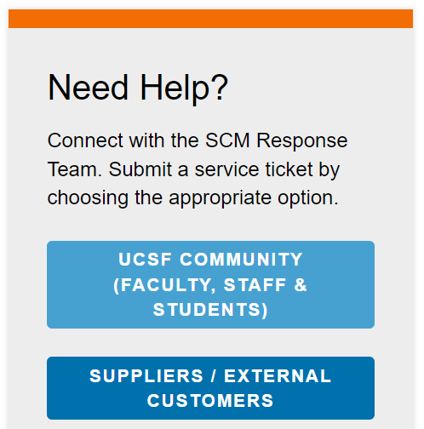
How To Get Help
UCSF employees and suppliers can connect with the SCM Response Team using the buttons on the Need Help? section of Supply Chain Management’s website:
supplychain.ucsf.edu

Slide 37

Questions & Answers
Please type your questions in the Zoom Q&A
Note: If we cannot answer all questions during
this webinar, we will post answers on our webinars page.

