Slide 1
AP Intern Final Presentation
Supply Chain Management

Slide 2
Introductions

Slide 3
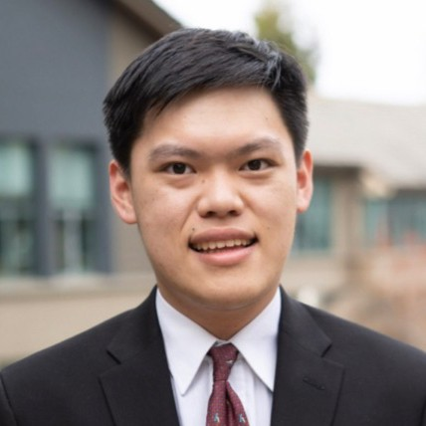
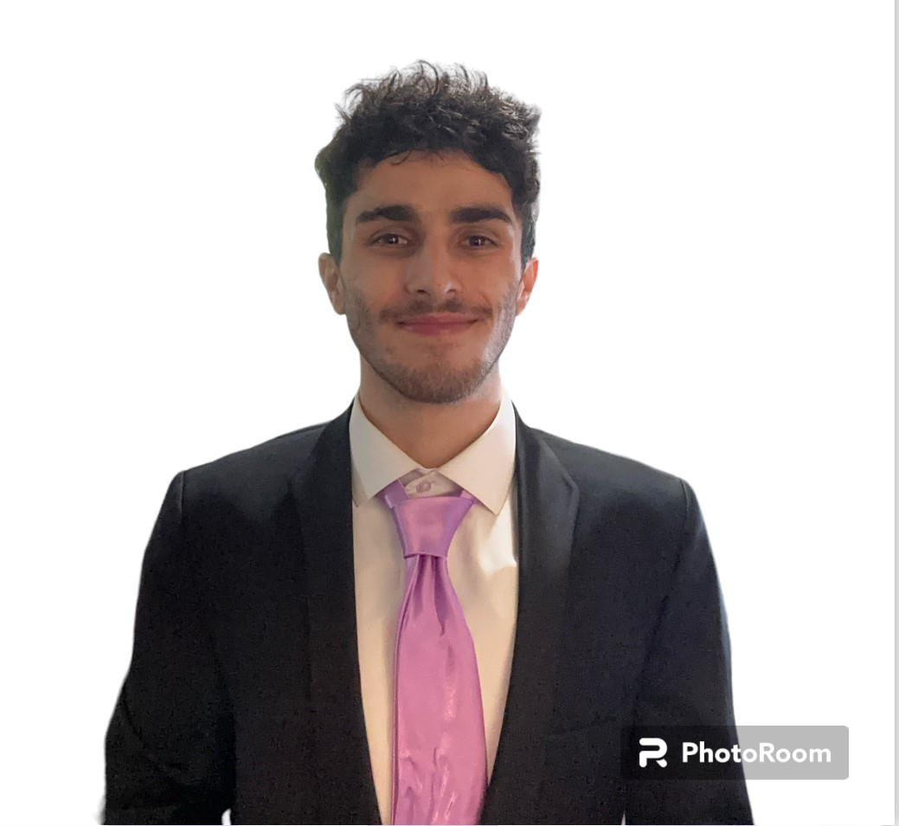
Nathaniel Irwan '24
Business Administration
UC Berkeley
Arman Moradi '24
Accounting
San Francisco State University
Jenna Rashkovsky '25
Applied Mathematics
UC Davis

Slide 4
Nathaniel Irwan
About Me
I am a senior at UC Berkeley and majoring in Business Administration. I joined UCSF SCM to learn more about how accounting principles are applied and how they facilitate connections between different entities.
Education
University of California, Berkeley
Business Administration
Experience
Accounting Assistant
Marque Luxury America LLC
Exploration
Behind the Scenes
What are the functions within accounting that effect individuals and corporate businesses?
linkedin.com/in/nathanielirwan

Slide 5
Arman Moradi
About Me
I am a senior at San Francisco State University studying accounting. I joined UCSF SCM to apply theoretical knowledge that I gained in the classroom to real world situations, as well as to explore a different area of accounting beyond tax.
Education
California State University, San Francisco
Accounting
Experience
Tax Intern
Withum
Exploration
Data
How can I use the data from prior year to forecast future years?
https://www.linkedin.com/in/arman-moradi-51734b210

Slide 6
Jenna Rashkovsky
About Me
I am a junior at UC Davis and majoring in Applied Mathematics. I joined UCSF SCM to gain experience in working with financial tools and data as well as improving my communication skills.
Education
University of California, Davis
Applied Mathematics
Experience
Corporate Accounting Intern
City of Hope Cancer Research Center
Exploration
Data Analysis
What is the importance of analyzing data within accounting?
linkedin.com/in/jenna-rashkovsky/

Slide 7
Payment Plus

Slide 8
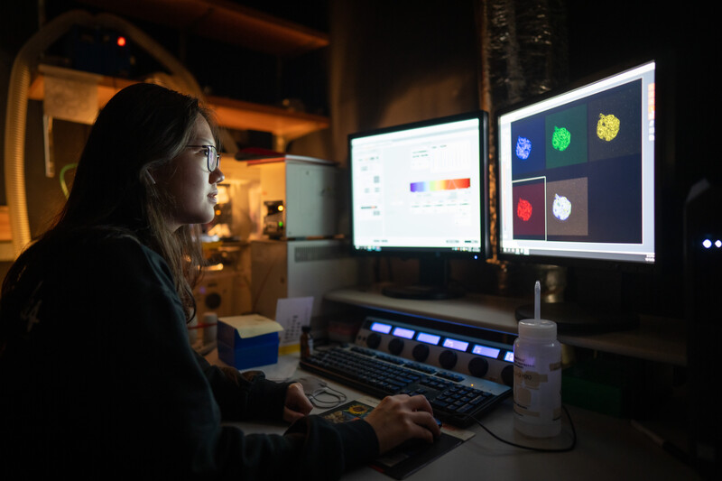
What is Payment Plus?
Payment Plus
It is a virtual card program managed and guaranteed by US Bank
It is the preferred electronic payment method for not just UCSF but encompasses all of the UC system.
This method does not require a credit card terminal/point of sale system or any manual payment processing.

Slide 9
Payment Plus Benefits
Payment Plus
Benefits to UCSF
Reduced Costs
(Automation) allows staff work on other high priority tasks
Enhanced Security and control
Benefits to Suppliers
Immediate access to funds (upon UCSF approval)
Secured delivery through automation
Real time notifications for each card payment

Slide 10
Payment Plus Solution Types
(STP) Straight-Through Processing
(SUA)​ Single-Use Accounts
For individual suppliers who are not currently set up with a credit card terminal.
Managed by U.S. Bank’s credit card service provider, Elavon.
Funds will be transferred from the STP Account to the supplier’s bank account automatically.
For suppliers who already accept credit cards.
Suppliers receive a payment authorization email for each payment.

Slide 11
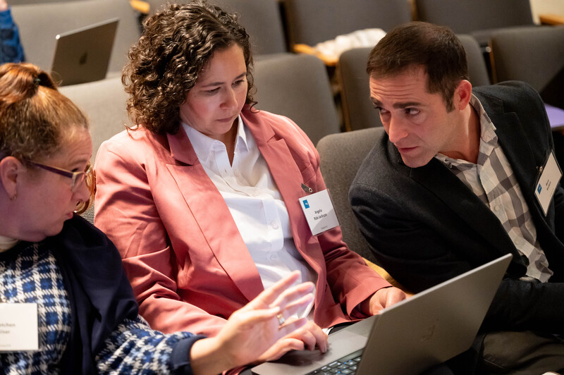
Our Goals

Slide 12
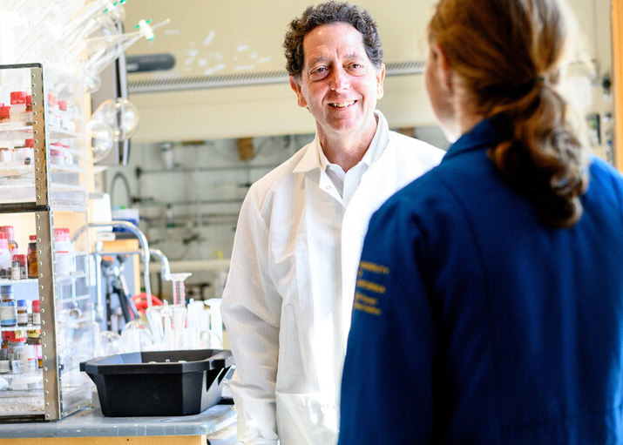
Our Purpose
Our Goals
Propose payment plus to the vendors of UCSF
Through email, call, etc
Get vendors in contact with our US Bank payment specialist!
Onboard companies and individuals

Slide 13
Day in a Life of an AP Intern

Slide 14
What do we do each day?
Life of an AP Intern: A Day
Research vendor information
How did we do the research?
Email, phone number, contact name, and website
Interns split the research and help each other if needed
Send out emails
Sort emails based on color for all interns (indicated on schedule)
Reply to emails using template
If stuck, ask for help!
Contact other interns with any questions

Slide 15
The Data

Slide 16
The Data
The Data
2 Campaigns
UCSF STP Campaign & UCSF VISA Campaign
Researched ~10000 Suppliers
Domestic & International Suppliers, Individuals, etc.
Outreached 3700+ Suppliers

Slide 17
Takeaways

Slide 18
Discoveries
Takeaways: The Lessons Learned
Working Remotely
Ability to navigate and manage school obligations
Learning & Applying New Skills/Techniques
Excel & Outlook Shortcuts (filter data, search, etc.)
Experience with Teams, BearBuy, Image Now
Amazing Team!
Very Open to Questions & Prioritized Understanding
Emphasized on Patience & Learning Together

Slide 19
Obstacles
Takeaways: The Challenges
Data Collection & History
Limited information on BearBuy, ImageNow, etc.
Formatting of data
Varying Structures and Configurations
Large & Incomplete Data Sets
Email Responses
Diverse vendor responses
Navigational challenges

Slide 20
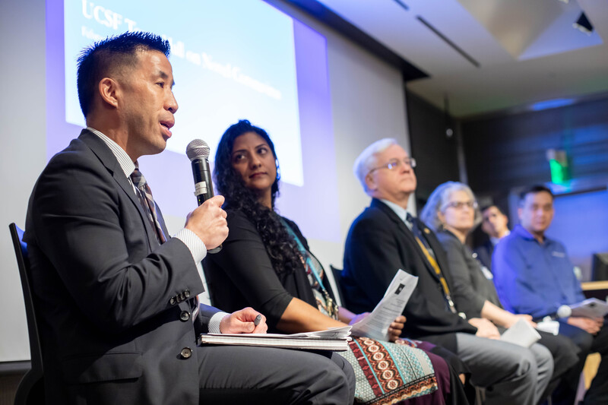
Suggestions
Takeaways: Areas for Growth
Implementation of New Technologies
Artificial Intelligence (scan invoices, extract data, etc.)
Real Time Data
Understanding progress of current efforts
Ex. total onboarded, declined, etc.
Team Meetings/Check-Ins
Outlining & communicating goals/ideas

Slide 21
What's Next?

Slide 22
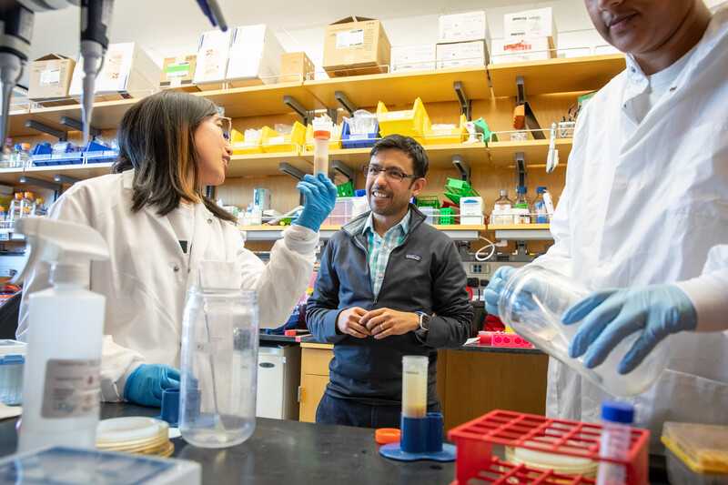
Plan of the Program
What's Next?
Expanding to Recruiting International Vendors
Reduce International Wire Transfers
Improve Efficiencies
Reduce costs
Eliminate manual process of wired payments

Slide 23
Nathaniel Irwan
What's Next?
Here is what's next!
University of California, Berkeley
B.S. Business Administration
Graduation
Learnings
Time Management & Efficiency
Remote Environment
Future Goals
Open to Opportunities
Enjoying today for a better tomorrow
linkedin.com/in/nathanielirwan

Slide 24
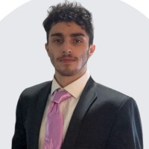
Arman Moradi
What's Next?
Graduation
California State University, San Francisco
B.S. Business Administration
Learnings
Data Analysis
Analyzing raw data in a meaningful way
Future Goals
CPA Certification

Slide 25
Jenna Rashkovsky
What's Next?
Here is what I have planned for the next chapter of my life!
Graduation
University of California, Davis
B.S. Applied Mathematics (2025)
Learnings
Communcation
Asking for help when necessary
Graduate School
Masters of Financial Engineering
Future Goals
linkedin.com/in/jenna-rashkovsky/

Slide 26
AP Intern Final Presentation
Supply Chain Management
Thank You!

